Slide 1
Chapter 6: The Impact of Economic Globalization
“Socialism collapsed because it did not allow the market to tell the economic truth. Capitalism may collapse because it does not allow the market to tell the ecological truth.”
… Oystein Dahle, former Vice-President, Exxon, for Norway and the North Sea
Notes:
What is your opinion about this statement?

Slide 2
Evaluating Economic Globalization
Criterion:
Health of the Earth
Growing Social and Economic Inequality
An Acceptable Standard of Well-Being

Slide 3
The Earth’s Free Ecosystem Services
Purification of air and water.
Water absorption and storage.
Decomposition and sequesters wastes.
Regeneration of soil nutrients.
Pollination, seed and nutrient dispersal.
Pest control.
Moderates wind and temperature extremes.
Agricultural, medicinal, and industrial products.
Biodiversity that performs all of the above tasks.
Aesthetic, spiritual, and intellectual uplift.

Slide 4
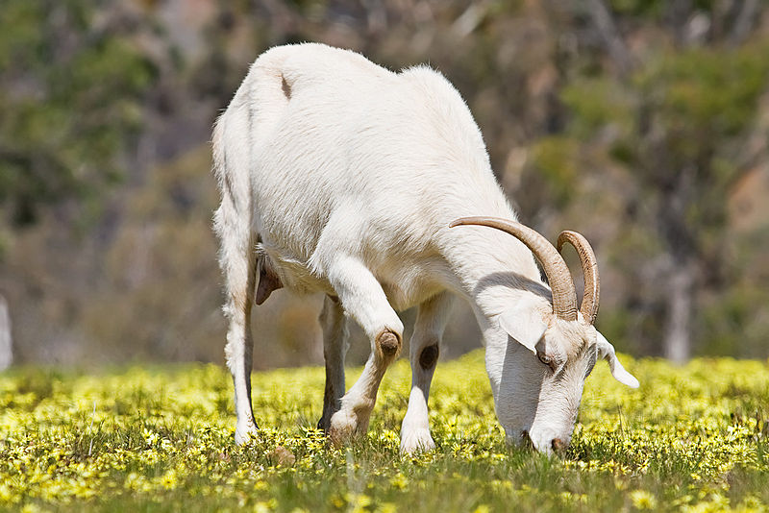
Earth is an Island
Notes:
Wikipedia

Slide 5
Environmental Issues
Desertification
Deforestation
Fresh Water
Climate Change
Sea Levels
Soil Depletion
Carrying Capacity
Human Populations
Natural Populations

Slide 6
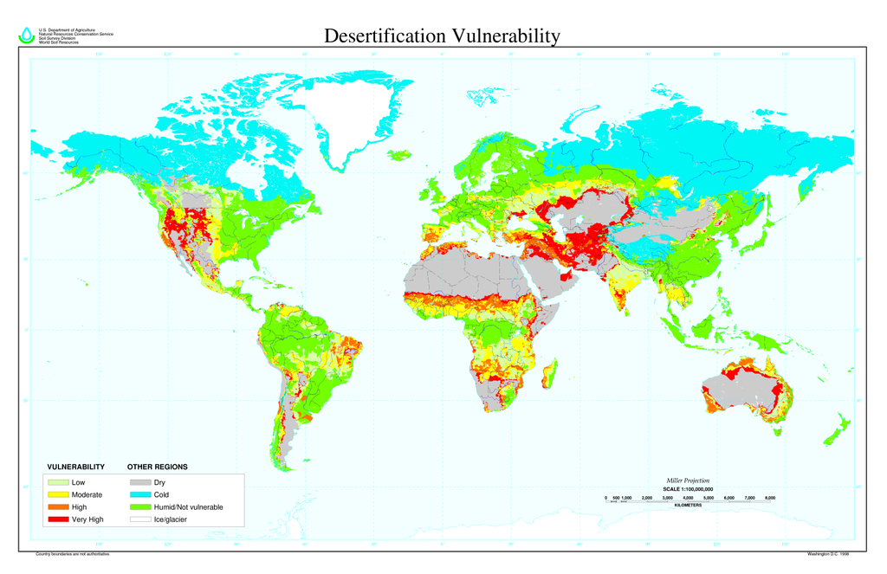
Desertification
Notes:
Global Desertification Vulnerability Map. Wikipedia

Slide 7
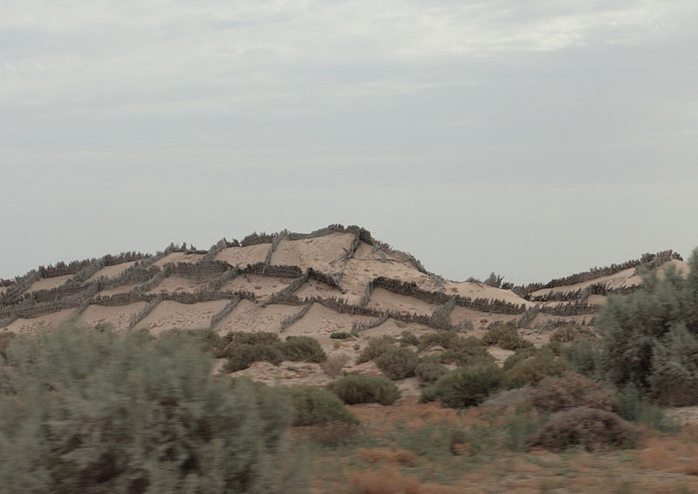
Desertification
Notes:
Vegetation barriers to keep the prowling desert at bay. Anti-sand shields protect agricultural plots in north Sahara, Tunisia, Africa.
Wikipedia

Slide 8
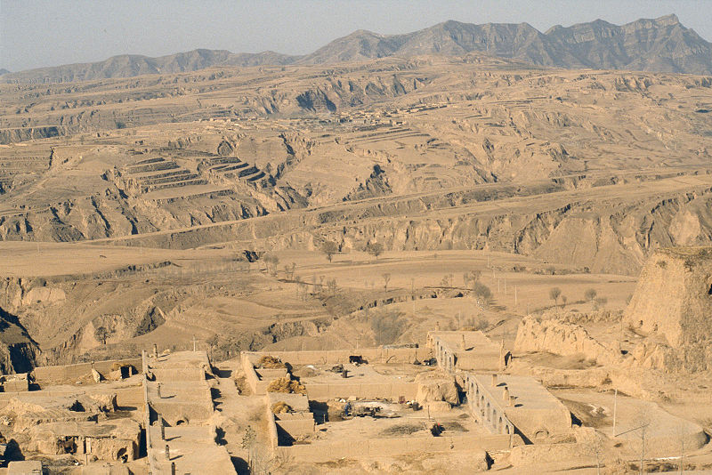
Desertification
Notes:
Loess soil near Hunyan, Shanxi province, China. Wikipedia

Slide 9
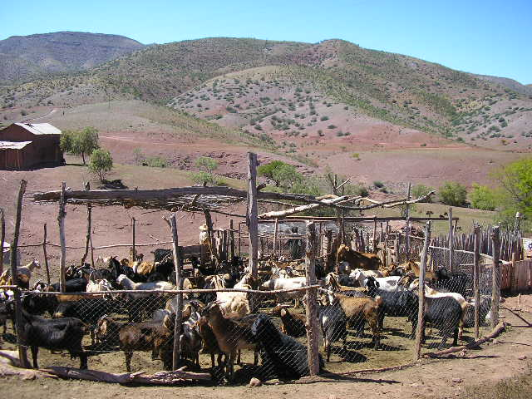
Desertification
Notes:
A herd of goats in Norte Chico, Chile. Overgrazing of drylands is one of the primary causes of desertification. Wikipedia

Slide 10
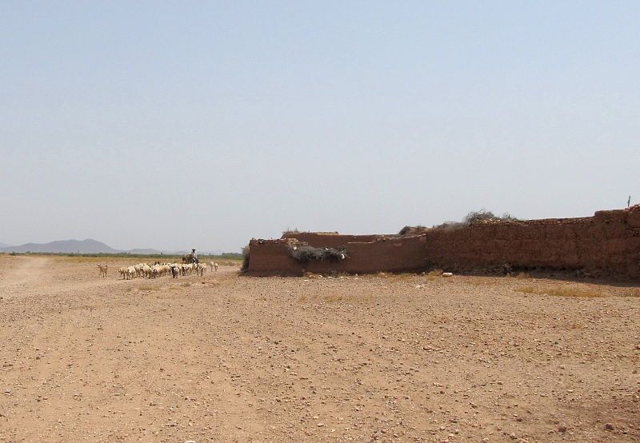
Desertification
Notes:
A shepherd guiding his sheep through the high desert outside of Marrakech, Morocco. Wikipedia

Slide 11
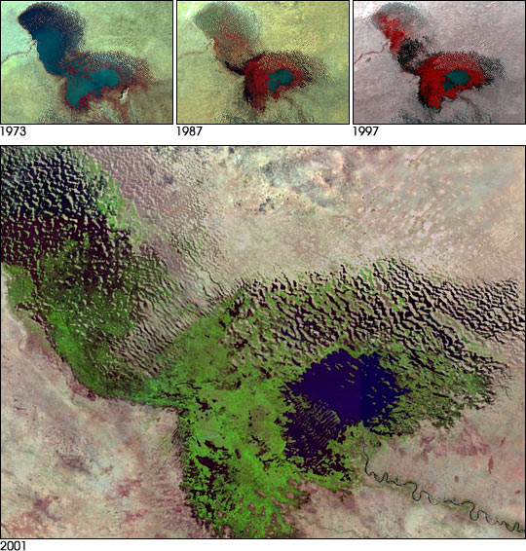
Shrinking Lake Chad
Notes:
Lake Chad in a 2001 satellite image, with the actual lake in blue. The lake has shrunk by 94% since the 1960s. Wikipedia

Slide 12
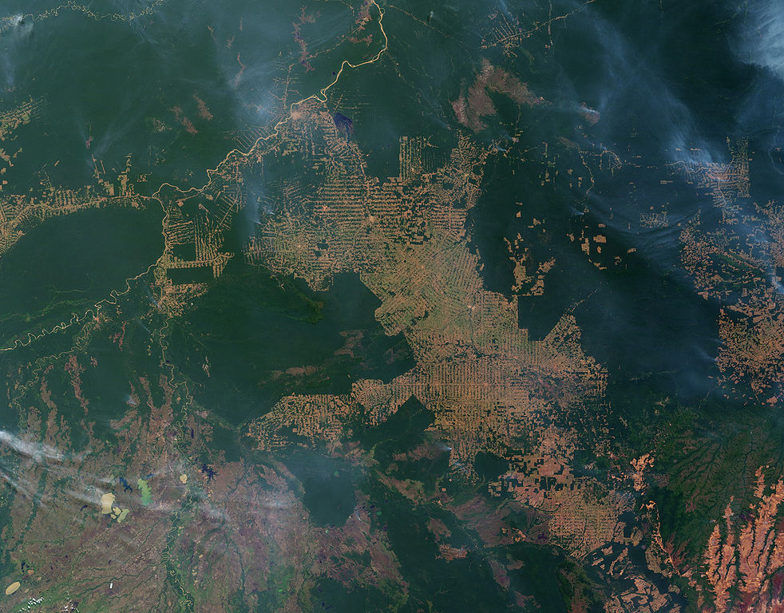
Deforestation
Notes:
Slash-and-burn farming in the state of Rondônia, western Brazil. Wikipedia

Slide 13
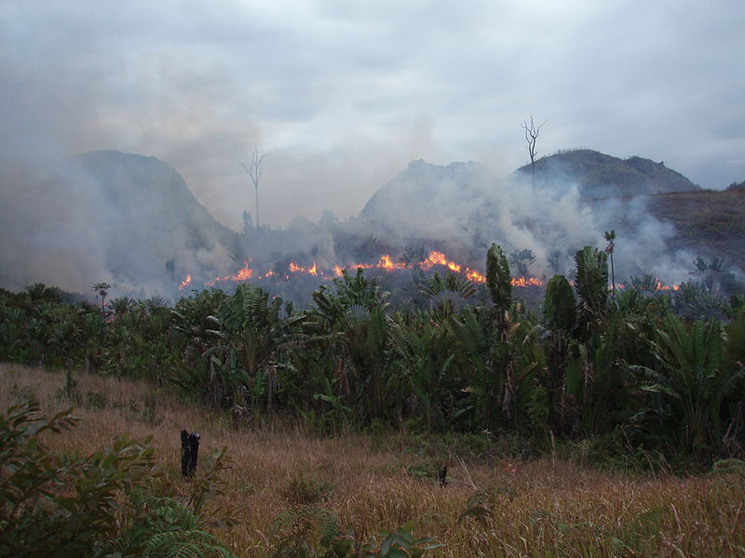
Deforestation
Notes:
Illegal slash and burn practice in Madagascar, 2010. Wikipedia

Slide 14
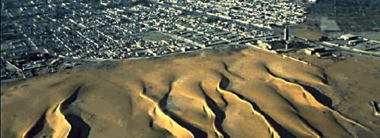
Desertification
Notes:
Nouakchott Sand Dunes encroaching upon Nouakchott, the capital and largest city in Mauritania. Wikipedia

Slide 15
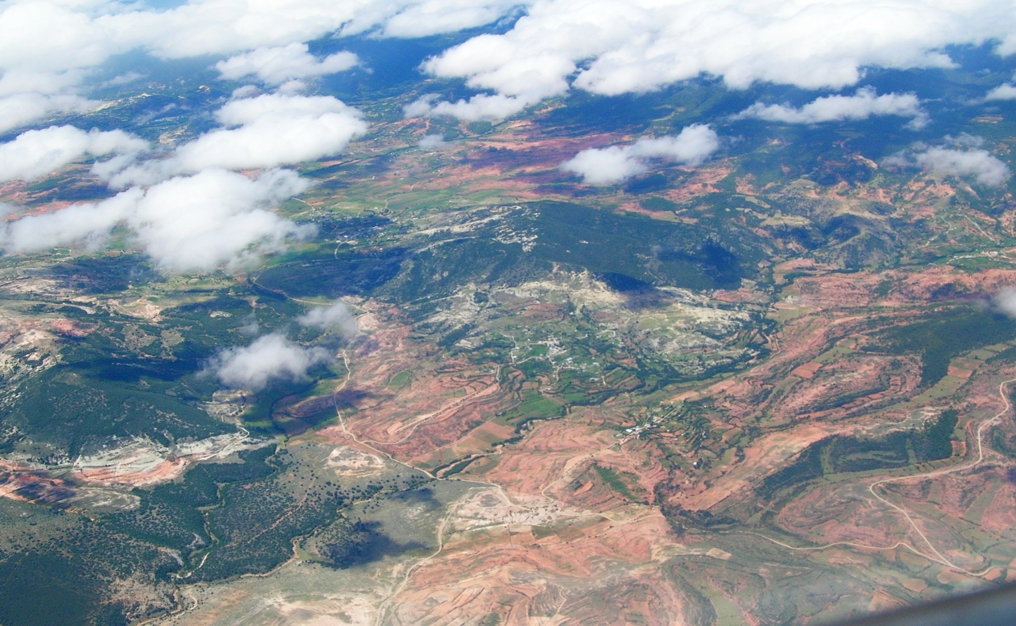
Deforestation
Notes:
Deforested land over Oaxaca, southern Mexico. Photo Denise Ames

Slide 16
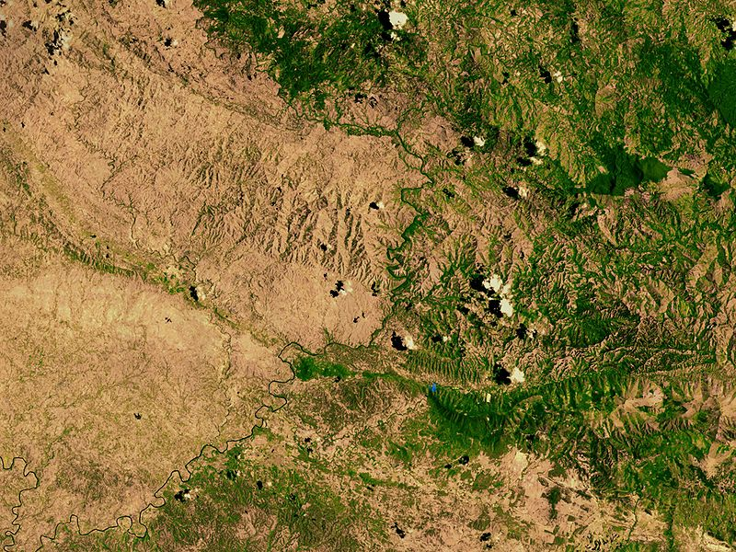
Deforestation
Notes:
Satellite image of Haiti’s border with the Dominican Republic (right) shows the amount of deforestation on the Haitian side. (Wikipedia)

Slide 17
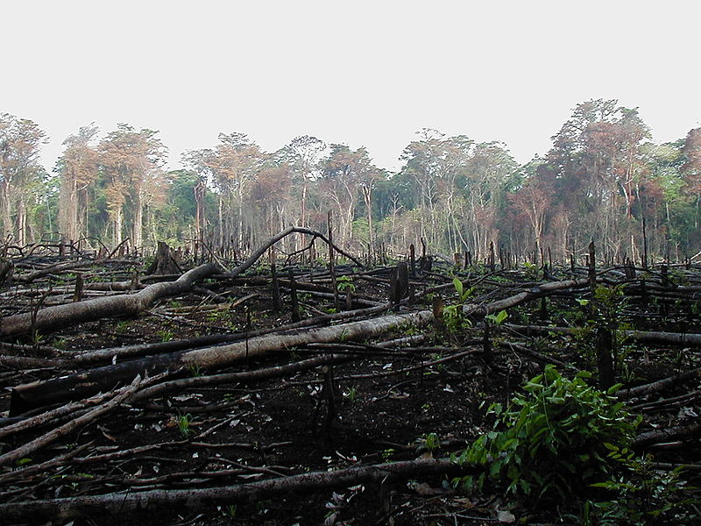
Deforestation
Notes:
Jungle burned for agriculture in southern Mexico. (Wikipedia)

Slide 18
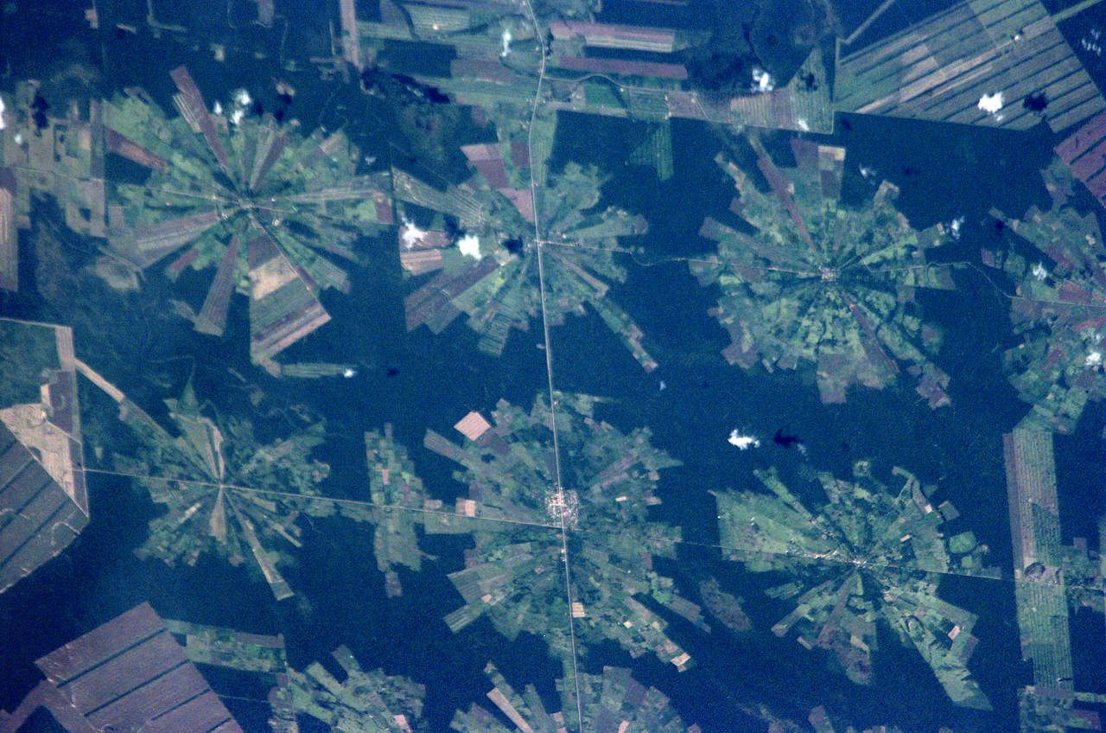
Deforestation
Notes:
Satellite photograph of deforestation in progress in the Tierras Bajas project in eastern Bolivia. NASA image 2001, Wikipedia

Slide 19
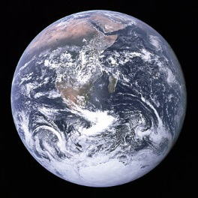
The Earth
Notes:
Earth seen from Apollo 17 — the Antarctic ice sheet at the bottom of the photograph contains 61% of the fresh water, or 1.7% of the total water, on Earth. Wikipedia

Slide 20
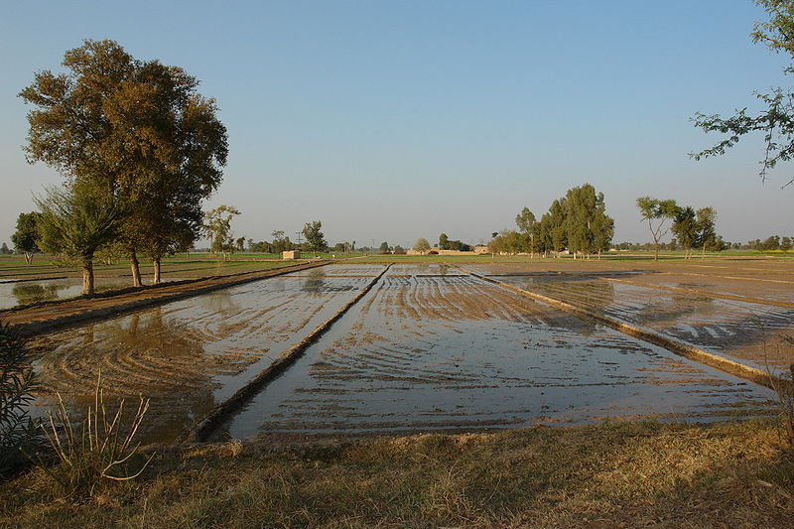
Fresh Water and Irrigation
Notes:
Irrigation of land in Punjab, Pakistan. (Wikipedia)

Slide 21
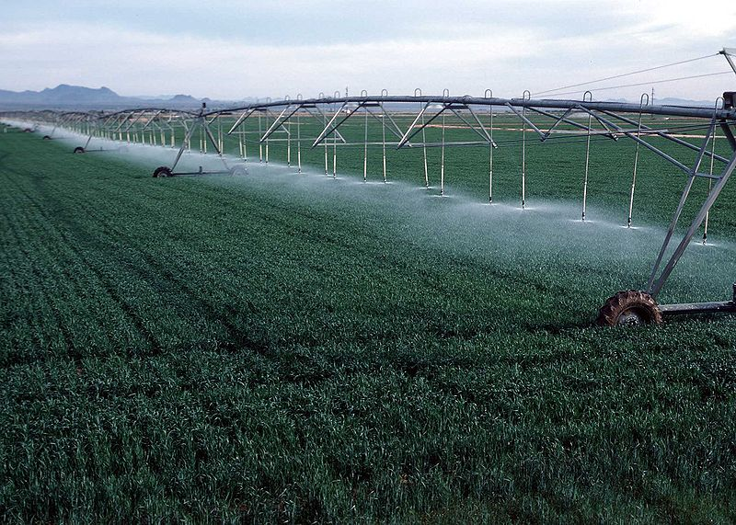
Fresh Water and Irrigation
Notes:
Center pivot with drop sprinklers, Yuma County, Colorado. (Wikipedia)

Slide 22
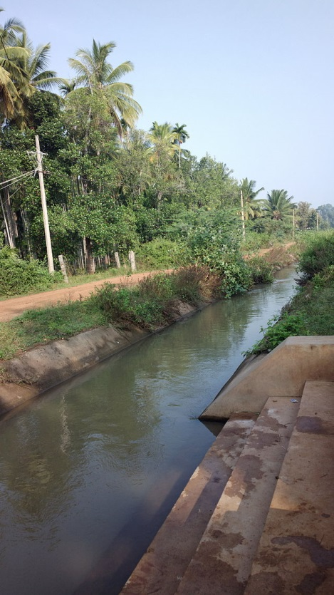
Irrigation Canal, India
Notes:
Irrigation canal near Channagiri, Davangere Village, India. Wikipedia

Slide 23
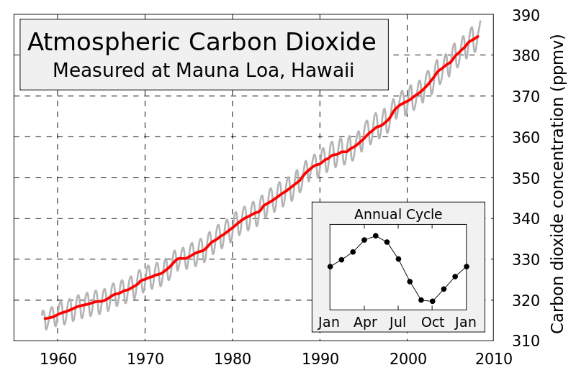
Climate Change
Notes:
Increase in atmospheric CO₂ levels. (Wikipedia) This figure shows the history of atmospheric carbon dioxide concentrations as directly measured at Mauna Loa, Hawaii. This curve is known as the Keeling curve, and is an essential piece of evidence of the man-made increases in greenhouse gases that are believed to be the cause of global warming. The longest such record exists at Mauna Loa, but these measurements have been independently confirmed at many other sites around the world. The annual fluctuation in carbon dioxide is caused by seasonal variations in carbon dioxide uptake by land plants. Since many more forests are concentrated in the Northern Hemisphere, more carbon dioxide is removed from the atmosphere during Northern Hemisphere summer than Southern Hemisphere summer. This annual cycle is shown in the inset figure by taking the average concentration for each month across all measured years. The grey curve shows the average monthly concentrations, and red curve is a moving 12 month average. Wikipedia

Slide 24
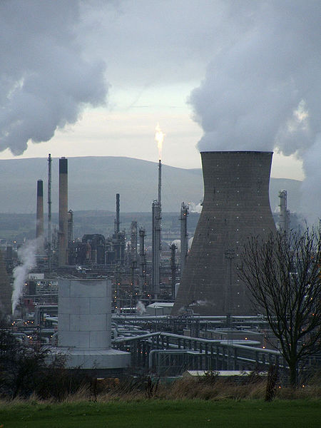
Climate Change
Notes:
A petrochemical refinery in Grangemouth, Scotland, UK contributes to climate change. (Wikipedia)

Slide 25
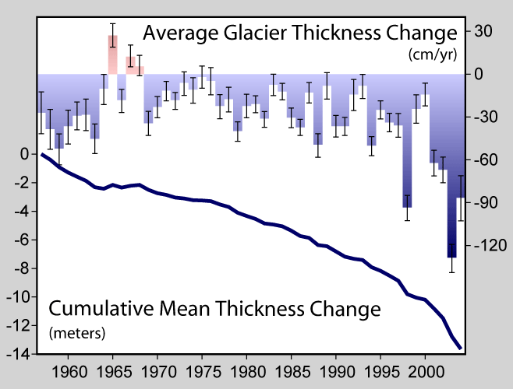
Notes:
Decline in thickness of glaciers worldwide over the past half-century. Wikipedia

Slide 26
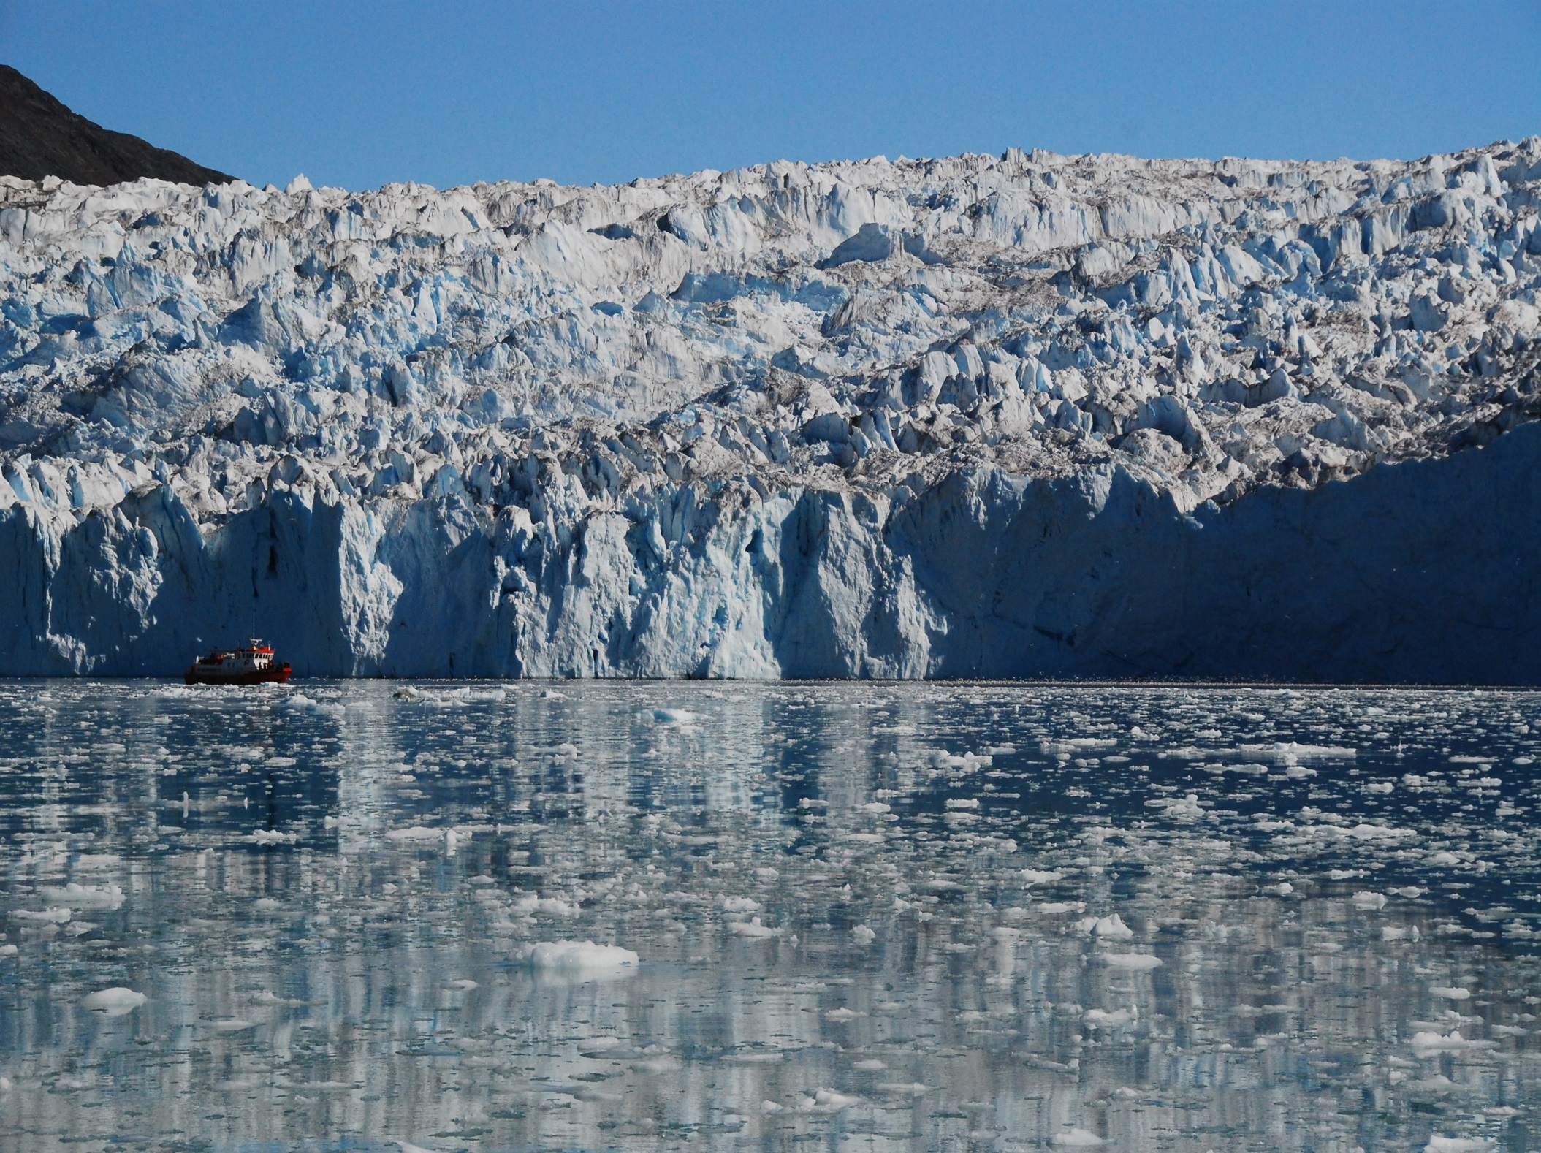
Notes:
Melting glaciers in Greendland. Wikipedia

Slide 27
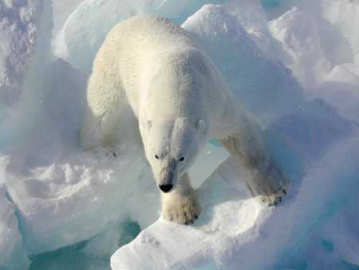
Notes:
Polar bears depend on diminishing sea ice as a platform for hunting seals. (Wikipedia)

Slide 28
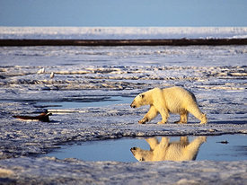
Notes:
Polar bears on diminishing ice. Wikipedia

Slide 29
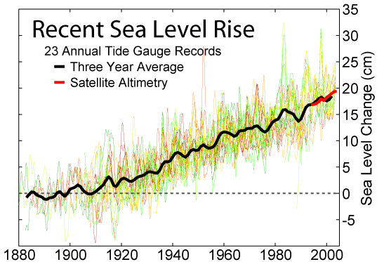
Notes:
Sea level measurements from 23 long tide gauge records in geologically stable environments show a rise of around 200 millimetres (7.9 in) during the 20th century (2 mm/year). Wikipedia

Slide 30
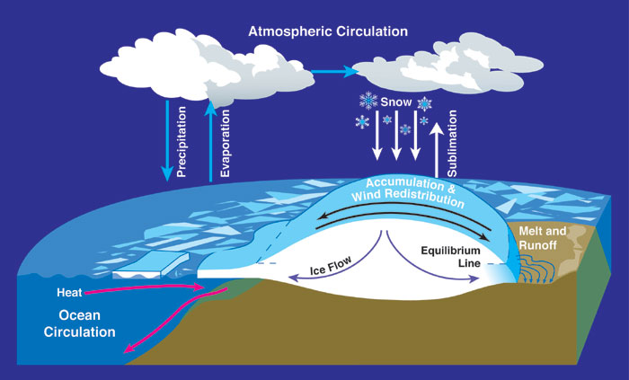
Sea Levels
Notes:
Water cycles between ocean, atmosphere and glaciers. NASA Wikipedia

Slide 31
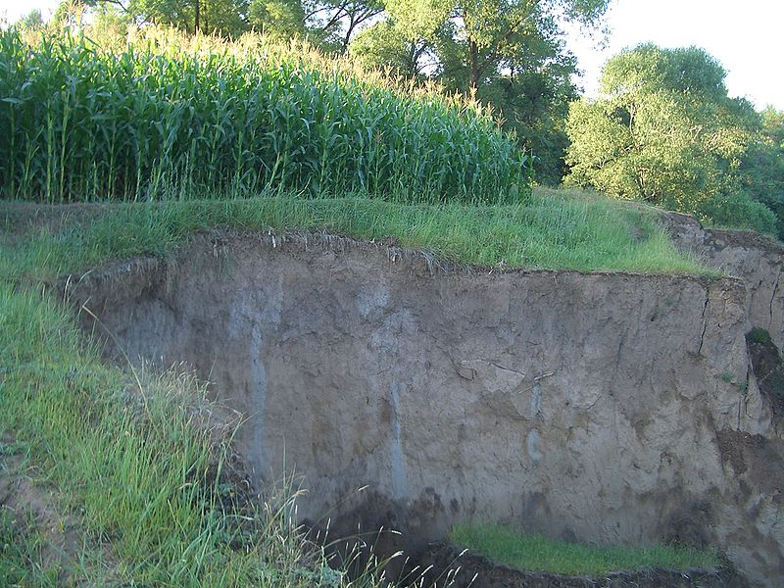
Soil Depletion
Notes:
Linxia, China, a farmer is gradually losing his land as the edge of the loess plateau is eroded away. (Wikipedia)

Slide 32
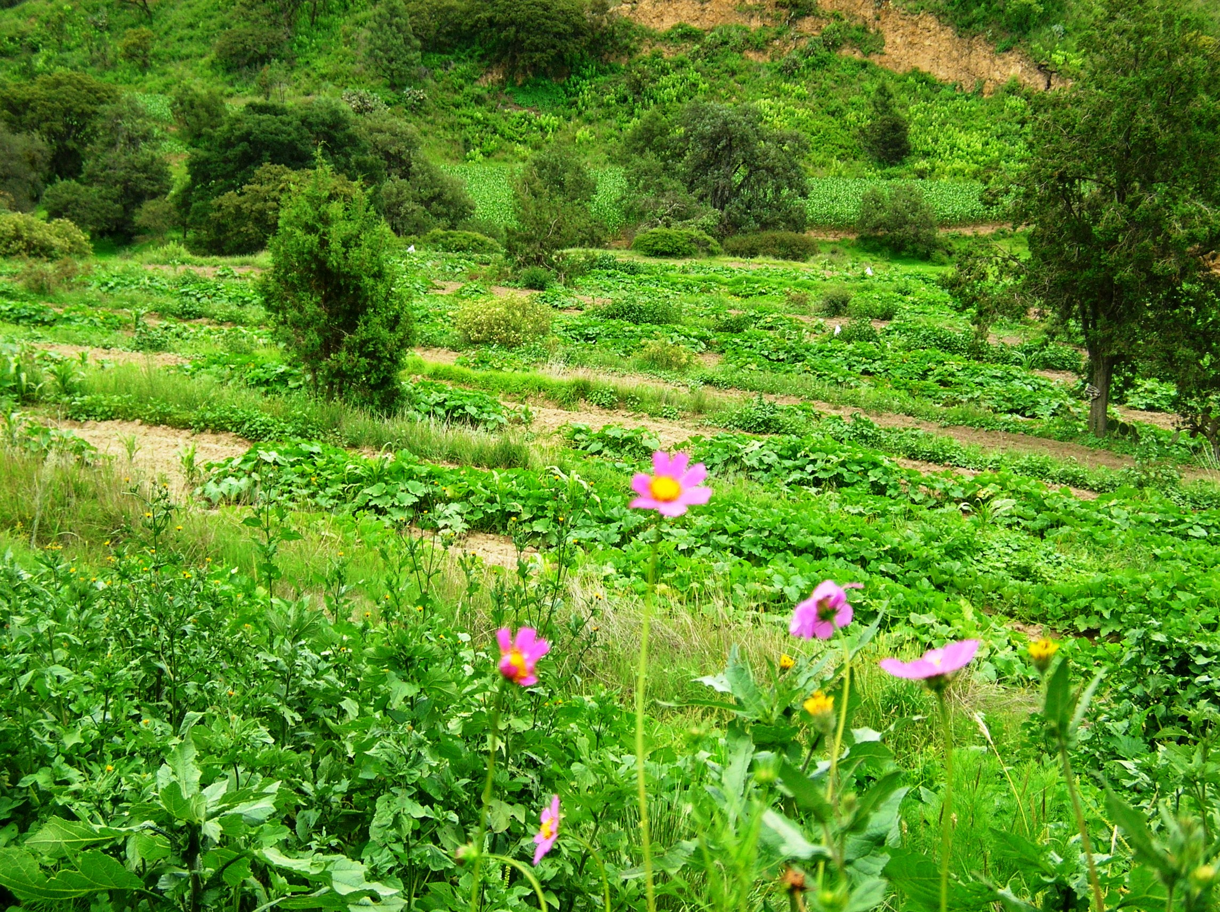
Soil Depletion
Notes:
Reclaimed terraced community farm in Vincente Geuerrero in the state of Tlaxaca, Mexico. Photo Denise Ames

Slide 33
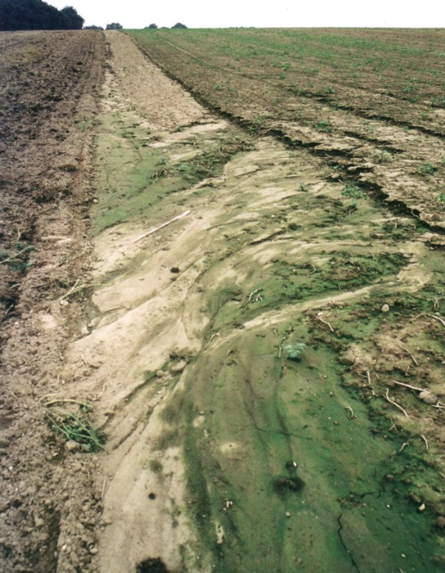
Soil Deple-tion
Notes:
Intensive tillage result in soil degradation. (Wikipedia)

Slide 34
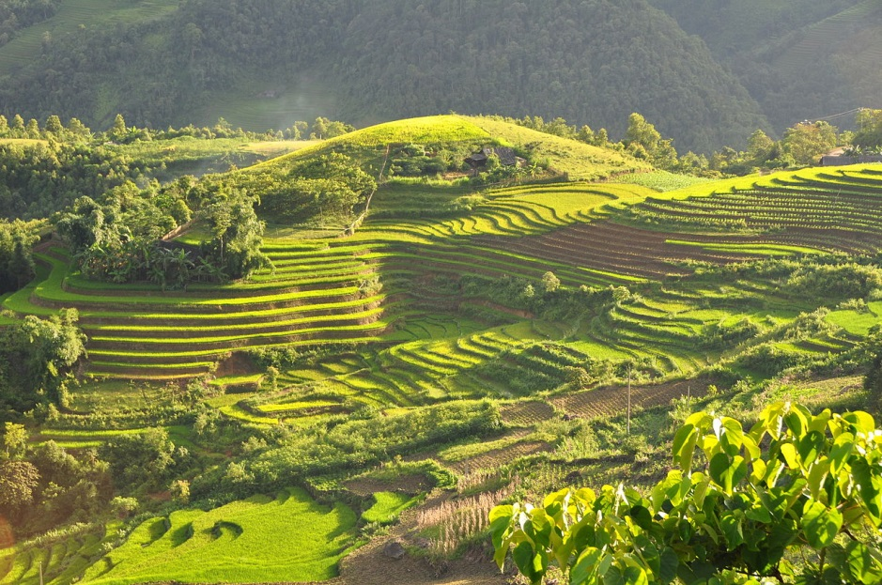
Terraced Fields
Notes:
Terraced fields in Sa Pa, Vietnam. Wikipedia

Slide 35
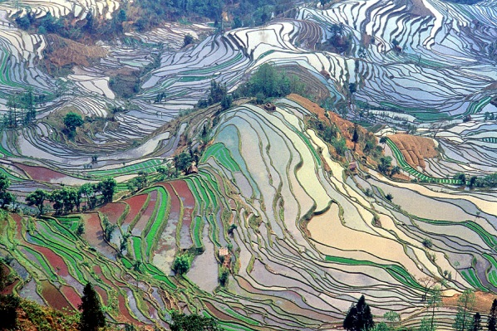
Notes:
Abstract pattern of terraced rice fields in Yuanyang County, Yunnan, China. Wikipedia

Slide 36
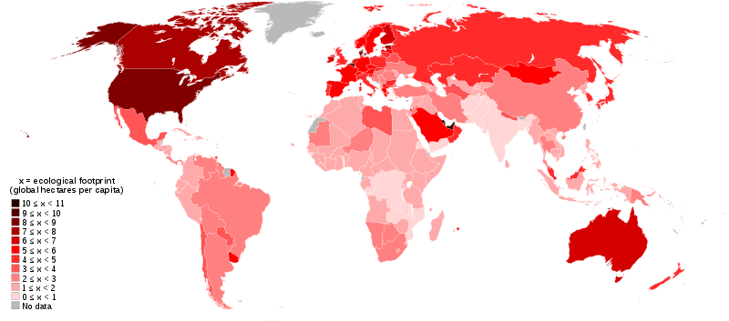
World Map according to Ecological Footprint
Notes:
World map of countries shaded according to their ecological footprint in 2007 (published on 13 October 2010 by the Global Footprint Network). It is measured by the amount of global hectares that are affected by humans per capita of the country. Lighter shades denote countries with a lower ecological footprint per capita and darker shaded for countries with a higher ecological footprint per capita. The total ecological footprint (global hectares affected by humans) is measured as a total of six factors: cropland footprint, grazing footprint, forest footprint, fishing ground footprint, carbon footprint and built-up land. Wikipedia http://en.wikipedia.org/wiki/File:World_map_of_countries_by_ecological_footprint_(2007)

Slide 37
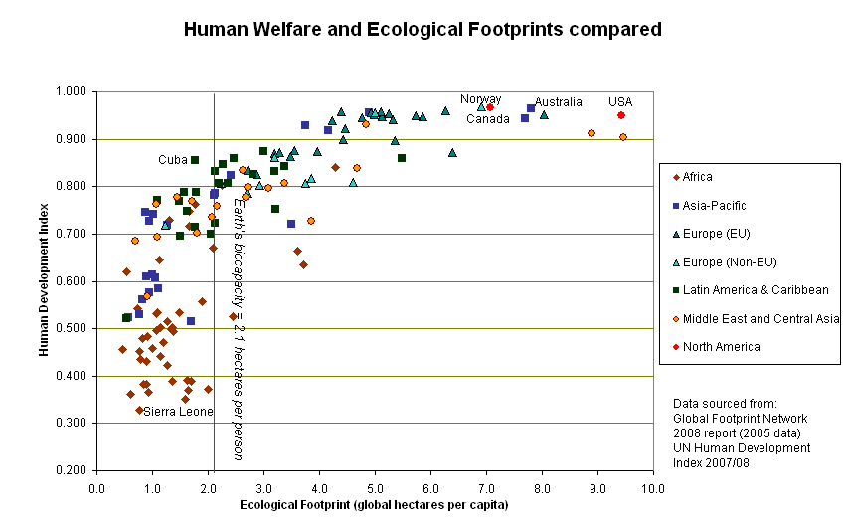
Notes:
Ecological footprint for different nations compared to their Human Development Index. Wikipedia

Slide 38
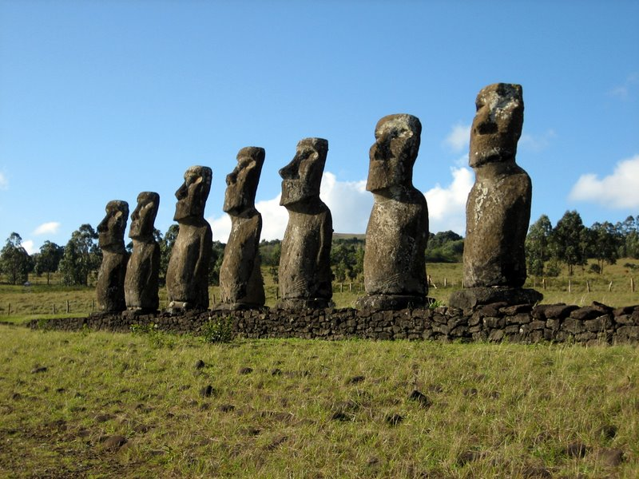
Overshoot: Easter Island
Notes:
Ahu Akivi, one of the few inland ahu, with the only moai facing the ocean. Easter island (1600-1799) experienced severe erosion due to deforestation and unsustainable agriculture, topsoil. Loss led to ecological collapse, causing mass starvation and civilizational disintegration. Wikipedia

Slide 39
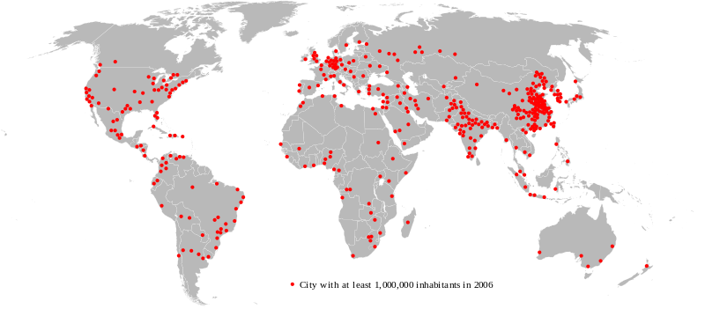
World Population Map
Notes:
Map showing urban areas with at least one million inhabitants in 2006. Only 3% of the world's population lived in cities in 1800; this proportion had risen to 47% by 2000, and reached 50.5% by 2010. By 2050, the proportion may reach 70%. Source: Wikipedia http://en.wikipedia.org/wiki/World_population

Slide 40
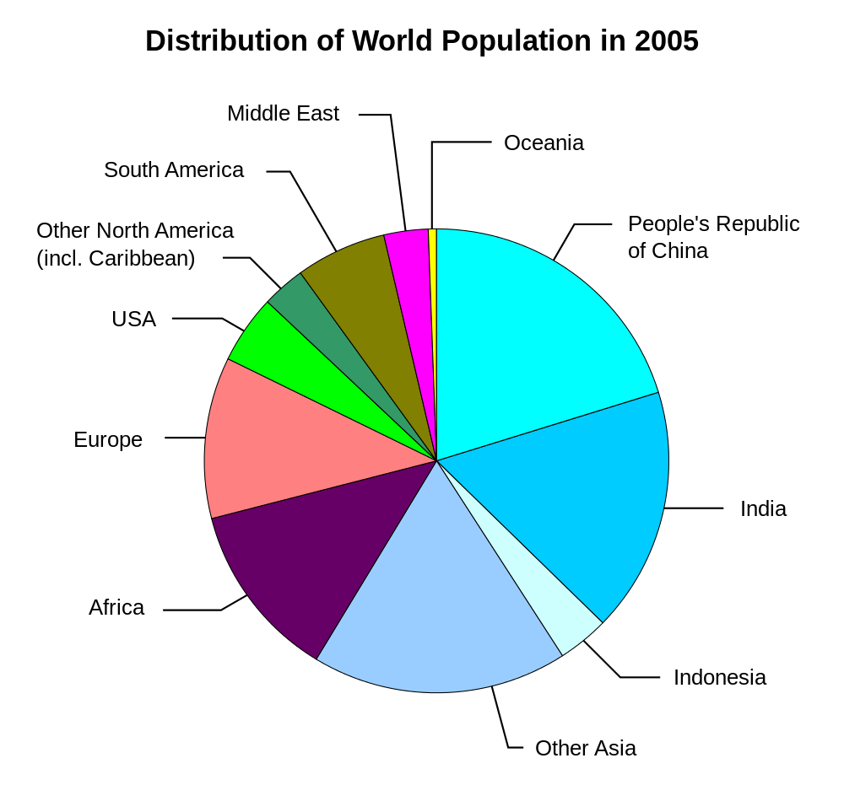
Notes:
Chart showing geographic distribution of the world population in 2005. Wikipedia: http://en.wikipedia.org/wiki/World_population

Slide 41
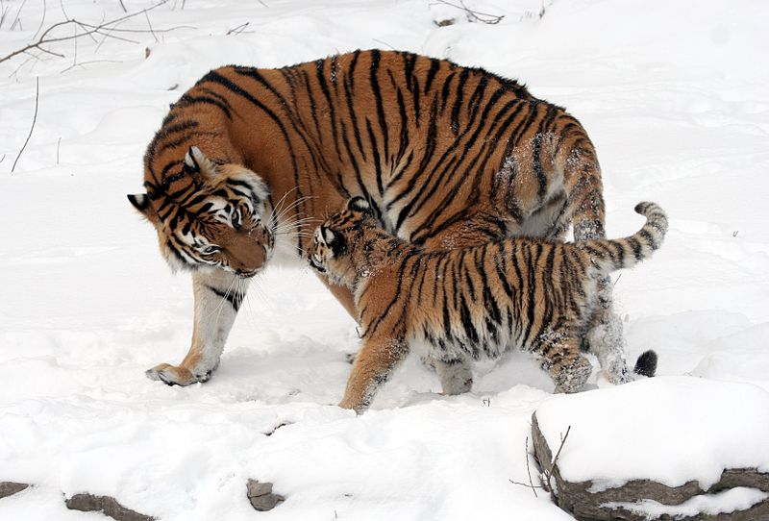
Notes:
The Siberian tiger is a subspecies of tiger that is endangered; three subspecies of tiger are already extinct. (Wikipedia)

Slide 42
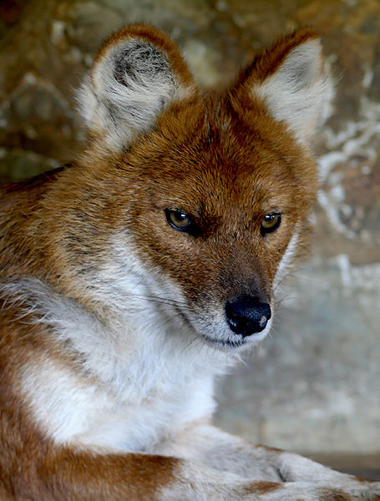
Notes:
The most endangered Asiatic top predator, the dhole, is on the edge of extinction. (Wikipedia)

Slide 43
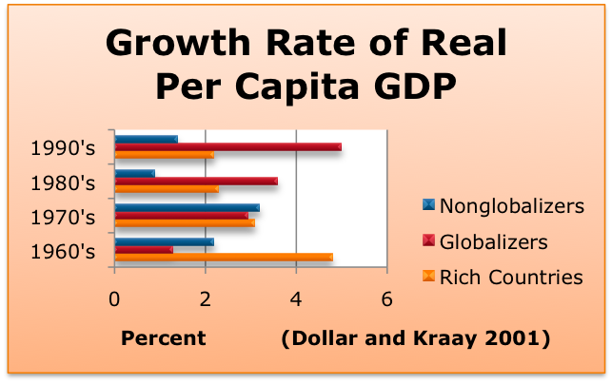

Slide 44

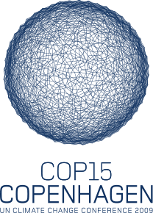
The Environment
Notes:
Earth Day 1970 logo, logo for the 2009 United Nations Climate Change Conference. Wikipedia

